Slide 1

Nebraska Mortgage Segments & Market Entry Strategy
A Quantitative study of FRM Market in Nebraska
Oct 13, 2021 Prepared by Vedang Vadalkar, Geran Wen, Xiaolong Chen, James Bae

Slide 2
Case Challenge: Analyzing the Nebraska Mortgage Loan Market
CASE CHALLENGE
Great Lakes Midwest Bank (GLMB), a regional bank is planning expanding its operations in Nebraska.
Before expanding their operations, they are surveying the health and opportunity of the Nebraska mortgage market.
A dataset from Fannie Mae was made available for analysis. About a quarter of all entries are “in-progress” mortgages and need to be predicted to obtain full picture.
The task is to analyze the dataset and determine which segments of the Nebraska mortgage market GLMB should focus on.
The primary consideration of the analysis is to maximize the dollar value of mortgages issued while limiting the number of mortgage delinquencies.
METHOD
A random forest classification model was built to predict outcomes of “in-progress” mortgages to arrive at full dataset.
The team built a Linear Regression model with knowable^{[1]} variables to slice the dataset into appropriate segments.
Team studied other sellers for better understanding of market dynamics, and for establishing a reference point to our market entry strategy.
KEY RESULTS
Created a 4-stage market entry plan with timelines and milestones.
Defined appropriate segments for different stages of the strategy.
In the end, the team projects Great Lakes Midwest Bank capture between $80M to $102M in mortgage issuance, which accounts for approximately 3.3% of the Nebraska Conforming FRM market.
[1] Knowable: defined as the variables that can be known at the point of mortgage issuance. For example, `F30_DTE` is unknowable when mortgage was newly issued.

Slide 3
The Prediction Model
After trying a few modeling methods, Random Forest Classifier performed the best
Cleaning & Parsing
Linear Regression
Classification - SGD
Random Forest
The team started off with cleaning the dataset and filling the missing data in preparation for data analysis.
The data was first converted to be parsed by the model. For classification methods such as Random Forest, factorial variables are converted to numerical values while the team kept a data legend.
Generalized Linear Regression was the first modeling attempted.
The model yielded poor results. The accuracy wasn’t high, and false negatives were especially high.
This model was later refined and used to assess the effects of variables on outcome (mature or delinquent).
The next classification model was Stochastic Gradient Descent.
But, as the data was too skewed towards successful mortgages, the model overfitted to the dataset, which resulted in many false negatives.
Then a Random Forest model was created from the decision trees and used on the dataset.
This time it outperformed all previous models and yielded the most consistent results.
Random Forest Model has:
100% accuracy in predicting the mortgages that are “in-progress” but will be prepaid or matured during the term.
95% accuracy in predicting the mortgages that will result in a delinquent status during their term.
88% accuracy in predicting the mortgages that will result in a Deed-in-Lieu or REO disposition status [Appendix A].
This model gave us a high degree of confidence in predicting the outcomes of the currently “in-progress” mortgages.

Slide 4
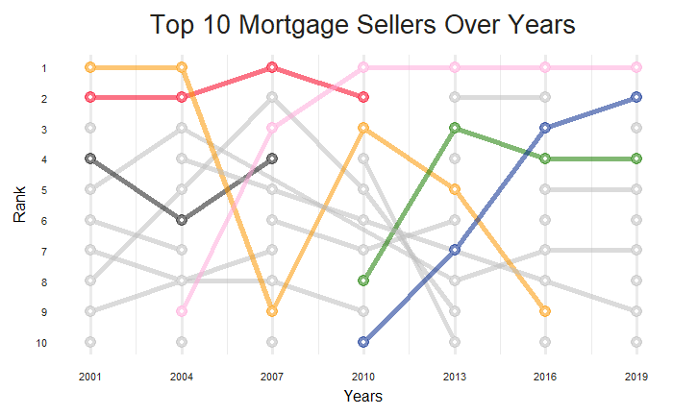
Market Analysis of Full Dataset
Analysis of dataset suggests NE’s market is competitive and allows space for newcomers.
Key Statistics
Fierce Competition
Nebraska’s Fixed-Rate-Mortgage (FRM) market has seen major reshuffle set on by 08’s financial crisis.
Top sellers from early 2000s (JPM, BOA) rarely stayed at top ten after 10+ years. Wells Fargo and U.S. Bank now dominates the market, along with non-bank entities such like Quicken Loan.
2.55%
Delinquency Rate
0.131%
Above
Fed Rate
751.92
Average Credit Score
Open Market
The share of “Other” sellers has steadily increased over the past two decades, suggesting that while top sellers dominate, other players including new entrants to the market have a decent chance to succeed
JPM
WFC
BOA
USB
FHB
QKN

Slide 5




Competitor Analysis of 4 Banks of Different Market Cap
Historic data from midsized regional banks provides reference point for GLMB’s target market share
Market Share (appx. range, recent) | 15% ~ 18% | 4% ~ 10% | 0.8% ~ 4% | 0.6% ~ 3%
Default rate (since 2009, q1~q2~q3) | 1.34% ~ 3.39% ~ 4.95% | 0.29% ~ 4.23% ~ 7.67% | 1.14% ~ 2.06% ~ 3.80% | 3.37% ~ 5.23% ~ 6.40%
Mean loan amount (q1~q2~q3)($) | 147.5K ~ 162.7K ~ 172.0K | 125.0K ~ 139.3K ~ 152.5K | 131.0K ~160.8K ~ 194K | 144.5K ~ 156.6K ~ 158.3K
Mean rate deviation^{[1]} (q1~q2~q3) | 0.184% ~ 0.1946% ~ 0.231% | -0.045% ~ 0.061% ~ 0. 153% | 0.135% ~ 0.173% ~ 0.227% | 0.246% ~ 0.295% ~ 0.348%
Mean credit score (q1~q2~q3) | 771.0 ~ 773.5 ~ 776.2 | 745.2 ~ 759.0 ~ 775 | 773.8 ~ 778.5 ~ 785.0 | 765.0 ~ 768.1 ~ 771.2
Market Cap (2019) | $222.43B | $90.96B | $33.06B | $2.16B
Branch Locations (appx.) | 5200 | 3067 | 1218 | 150
Operating States | 50 + DC | 26 | 11, Southern + DC | 5, Midwest + California
Ranking (2019) | 1 | 2 | 9 | 7
Conclusions:
Although both large banks dominate the market, mortgages by Wells Fargo have very different profile from U.S. Bank.
While Wells Fargo consistently targets those requesting higher than average loan amounts, borrowers of U.S. Bank consistently have lower credit score, and request less in loan. Borrowers of U.S. Bank also have higher default rate.
Truist and Flagstar both have similar market share in NE FRM market: less than top players, but noteworthy given its resources. As a regional bank, GLMB should realistically aim to capture a similarly-sized market share.
Numbers from Flagstar and Truist bank serves as our references.
[1] Rate Deviation: defined as the difference between mortgage original interest rate and the Federal Reserve interest rate at the month of mortgage issuance.

Slide 6
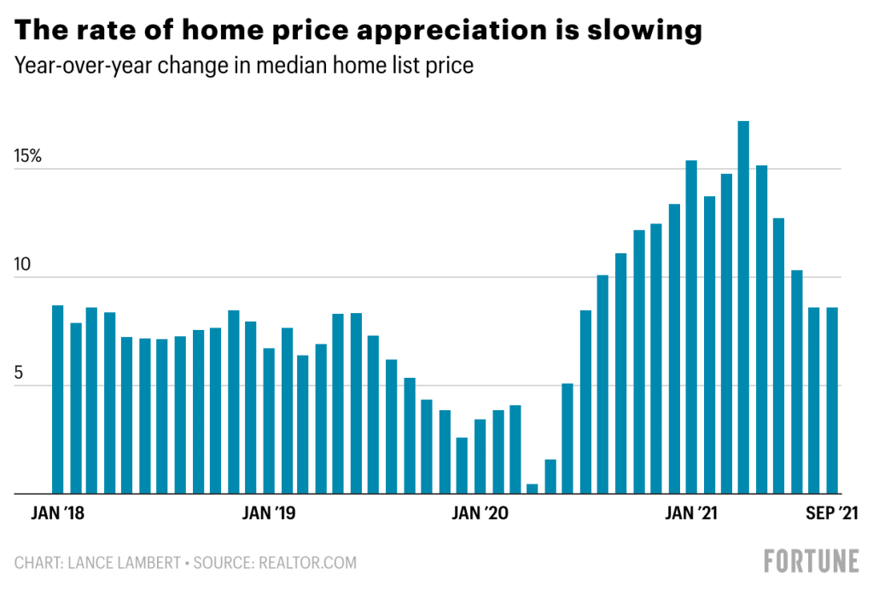
Future Market Conditions
Future market conditions remain uncertain amid rising inflation, high CPI, hot housing market, & imminent rise in interest rates in FY22
Currently, there is rising inflation in all sectors of the economy due to supply chain bottlenecks, labor shortage, and changing workplace requirements.
The new housing inventory is running low driving the prices higher due to labor shortage and supply constraints.
Due to COVID-19, the people who could work remotely, shifted to a remote only working environment. This drove up the demand for single family houses and increased demand in higher-end housing market.
Due to the easy monetary policy maintained by the Federal Reserve to support the market recovery from COVID-19, the interest rates are at record lows right now. This is expected to change once the Fed increases the interest rates in FY22.
With supply chain issues still plaguing the markets and workers starting to return to office the demand for housing is easing compared to its highs in March 2020 - April 2021. But the future remains uncertain due to the new COVID variants and the pace of reopening of the economy.
Figure 1
Fig 1: https://fortune.com/2021/10/05/housing-market-softening-bidding-wars-price-appreciation/

Slide 7
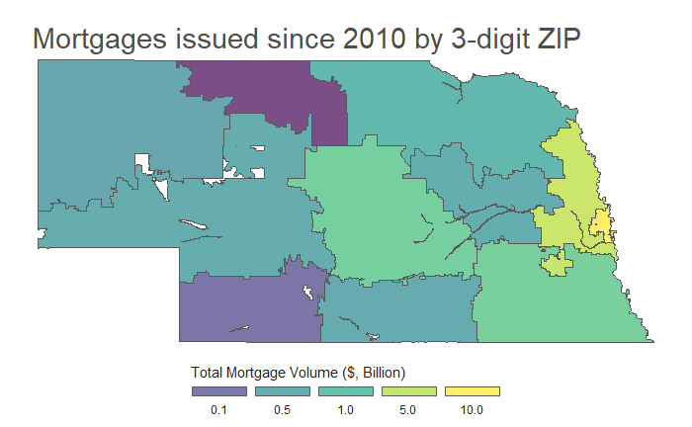
Variables to Define Segments
Identified key variables and their effects to define segment with low delinquency rates
Variables with Significant Impact
A Linear Regression Model^{[1]} was created with only variables knowable at time of mortgage issuance, to check effects of each.
All variables listed above have strong statistical significance.
Geographic Distribution
Nebraska’s economy leans heavily to the east, centered in and around Omaha. Most mortgage lending takes place in Omaha, its suburbs, and Lincoln. (3-digit ZIP of 681, 680, & 685)
Variables
Effects
Principal Residence | 0.753
Purpose: Purchase | 0.643
Purpose: Refinance | 0.366
Original Interest Rate | 0.164
Credit Score Average | 0.016
Debt-To-Income ratio | -0.015
Rate Deviation | -0.477
Grand Islands NE, MSA^{[2]} | -0.563
Property Type: Mfd. Home | -1.081
Mature
Omaha
Lincoln
Delinquent
These variables are the most important variables in defining segments to reduce likelihood of delinquency.
GLMB should open its first branch in Omaha, and gradually expand westward.
[1] Full model approach and results can be found in appendix B
[2] Grand Island MSA is a strong predictor of mortgage delinquency. Our market entry will prioritize other areas in Nebraska.

Slide 8
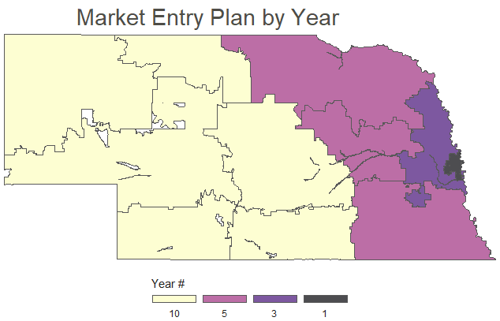
Proposed Market Entry Strategy Overview
A 10-Year plan to firmly establish market presence in Nebraska with timeline and milestones
Y1 Segment
Omaha only
Single Family or Condo
Primary residence
No cash-out refinance
Low DTI, interest rate
Low loan amount
High credit score
$1.7~1.2M loan amount
0.05% market share
Y3 Segment
Greater Omaha + Lincoln
Primary or secondary
All property type except Manufactured House
No cash-out refinance
Higher loan amount and DTI
$9.2~7.2M loan amount
0.30% market share
Y5 Segment
East Nebraska
Primary, secondary, investment
Westward Expansion
The market entry strategy has two significant characteristics.
Strategy is to start from the east, where higher economic activities, and expand to the west.
The segment begins narrowly defined, selecting for factors that lower delinquency rate, and gradually widens segment range.
Add cash-out refinance
Broader interest rate and credit score range
$38.7~26.4M loan amount
1.08% market share
Y10+ Segment
All Nebraska
Further broadened interest rate range
Further broadened credit score range
$101.6~80.1M loan amount
3.34% market share

Slide 9
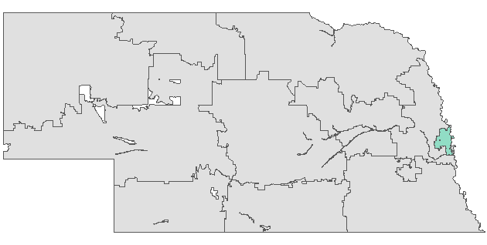
Year 1 Segment and Milestones - Omaha
Risk-averse strategy with narrow focus to establish presence in Omaha
Segment A
Range Analysis
Variables
Range
Location:
The first branch in Nebraska should be in Omaha, the economic center with the most mortgage activities. High marginal gain.
Property Type:
Single family & condo are positively related to mortgage success, lowering default rate.
Loan Purpose:
Compared to other purposes, cash-out refinance positively correlates to default.
Rate Deviation, Credit Score, Original Amount, Debt-to-income: Selected ¾ of full dataset that has lower default rate, based on model.
3-digit ZIP code: | 681 (Omaha)
Property Type | Single family & condo
Loan Purpose | Exclude cash-out refinance
Occupancy | Primary residence only
Rate Deviation | Below 3rd quantile
Credit Score Average | Above 1st quantile
Original Loan Amount | Below 3rd quantile
Debt-to-income | Below 3rd quantile
Expected Results
Segment | Segment Share of Total Market | Bank’s Target Share of Segment | Bank’s Expected Mortgage Volume | Target Share of Total NE Market
Segment A | Around 5% | Around 1% | Between $1.2 and $1.7 Million | 0.05%

Slide 10
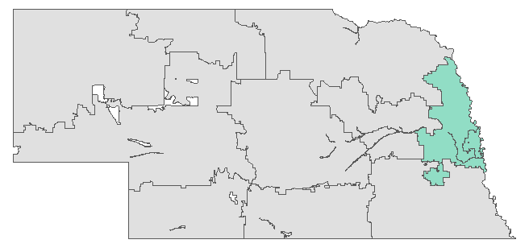
Year 3 Segments and Milestones – Omaha + Lincoln
Broaden physical presence & risk appetite to ensure high marginal return
Segment B, C, & D
Range Analysis – Changes
Variables
Range
Location:
Expand to include Lincoln and suburbs between Lincoln and Omaha
Property Type:
Expanded to all property types except Manufactured Homes, which positively correlates to default.
Occupancy:
Expanded the occupancy status to also include secondary.
Original Amount, Debt-to-income: Extended from ¾ of full dataset to under Fannie Mae limits.
3-digit ZIP code: | 681 (B: Omaha) & 685 (C: Lincoln) & 680 (D: Omaha suburbs)
Property Type | Exclude Manufactured Home
Loan Purpose | Exclude cash-out refinance
Occupancy | Principal & Second
Rate Deviation | Below 3rd quantile
Credit Score Average | Above 1st quantile
Original Loan Amount | Below Fannie Mae Max^{[1]}
Debt-to-income | Below Fannie Mae Limit of 50%
Expected Results
Segment | Segment Share of Total Market | Bank’s Target Share of Segment | Default Rate | Bank’s Expected Mortgage Volume | Target Share of Total NE Market
Segment B | Around 20% | Around 1% | ~2.0% | Between $4.5 and $6M | 0.200%
Segment C | Around 9% | Around 0.5% | ~1.5% | Between $1.3 and$1.5M | 0.045%
Segment D | Around 11% | Around 0.5% | ~1.5% | Between $1.4 and $1.7M | 0.055%
Aggregate: |  |  |  | Between $7.2 and $9.2M | 0.300%
[1] Fannie Mae’s limit on maximum loan amount are different from year to year and periodically adjusted.

Slide 11
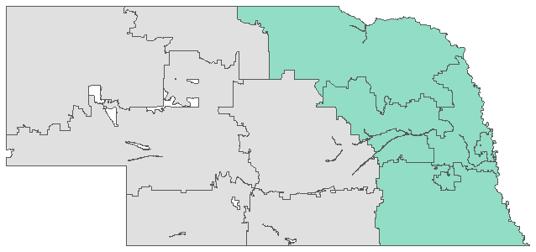
Year 5 Segments and Milestones – East Nebraska
Grow GLMB’s presence and widen segment definition to capture higher market share
Segment E & F
Range Analysis - Changes
Variables
Range
Location:
Expand to include all east Nebraska (3-digit ZIP of 683, 686, 687)
Loan Purpose:
Expand to include Purchase, Cash-out, and Refinance.
Occupancy:
Expanded the occupancy status to also include investment.
Rate Deviation, Credit Score, Original Amount, Debt-to-income: Lifted rate deviation threshold to 85th percentile, lowered credit score threshold to 15th percentile, so that a wider segment may qualify.
3-digit ZIP code: | 680, 681, 685 (E) & 683^{[1]} , 686, 687 (F)
Property Type | Exclude Manufactured Home
Loan Purpose | Purchase, Cash-out, Refinance
Occupancy | Principal & Second & Investor
Rate Deviation | Below 85th percentile
Credit Score Average | Above 15th percentile
Original Loan Amount | Below Fannie Mae Max
Debt-to-income | 50% of Fannie Mae Limit
Expected Results
Segment | Segment Share of Total Market | Bank’s Target Share of Segment | Default Rate | Bank’s Expected Mortgage Volume | Target Share of Total NE Market
Segment E | Around 50% | Around 2% | ~2.5% | Between $24 and $36M | 1.000%
Segment F | Around 5% | Around 1.5% | ~2.5% | Between $2.4 and$2.7M | 0.075%
Aggregate |  |  |  | Between $26.4 and $38.7M | 1.075%
[1] 3-digit ZIP code of 683 is a merger of 684 and 683. Check Appendix B for details.

Slide 12
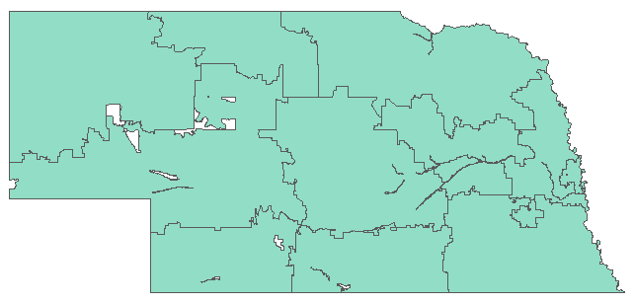
Year 10+ Segments and Milestones – Entire Nebraska
Become an established institution in NE with significant and stable market share
Segment G & H
Range Analysis - Changes
Variables
Range
Location:
The branch expanded to include all Nebraska areas.
Rate Deviation, Credit Score, Original Amount, Debt-to-income:
Lifted rate deviation threshold to 90th percentile, lowered credit score threshold to 10th percentile, so that a wider segment may qualify.
3-digit ZIP code: | East NE (G) & West NE (H)
Property Type | Exclude Manufactured Home
Loan Purpose | Exclude Refinance-Not Specified
Occupancy | Principal & Second & Investor
Rate Deviation | Below 90th percentile
Credit Score Average | Above 10th percentile
Original Loan Amount | Below Fannie Mae Max
Debt-to-income | 50% of Fannie Mae Limit
Expected Results
Segment | Segment Share of Total Market | Bank’s Target Share of Segment | Default Rate | Bank’s Expected Mortgage Volume | Target Share of Total NE Market
Segment G | Around 76% | Around 4% | ~2.5% | Between $72 and $92 Million | 3.04%
Segment H | Around 10% | Around 3% | ~3.5% | Between $8.1 and$9.6 Million | 0.30%
Aggregate |  |  |  | Between $80.1and $101.6 Million | 3.34%

Slide 13
Summary
In this work, we predicted the “on-going” mortgages using machine learning algorithms, specifically Random forest classifiers.
We found the random forest models to have the highest accuracy in predicting mortgages “in progress”, compared to other models tested.
We conducted competitor analysis and set our reference point at midsized banks like Flagstar and Truist, in order to establish better entry strategy.
We expect the future market to remain uncertain due to COVID-19, future increase in interest rate, worldwide supply chain issues, and labor shortages.
We proposed a business plan with detailed segment for Year 1, Year 3, Year 5, & Year 10+. According to our business plan, Great Lakes Midwest Bank will reach 3.34% of Fixed-Rate-Mortgage market in Nebraska.

Slide 14
Thank you
From Team 46

Slide 15
Appendix A
Model assumptions, parameters, and performance

Slide 16
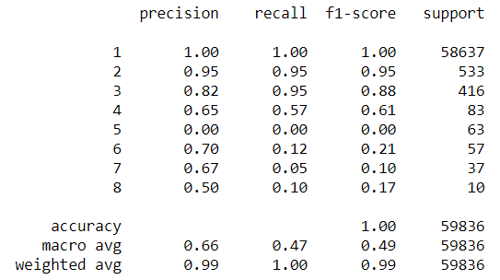
[Random Forest] The Prediction Model
Full Random Forest Model Breakdown
Preparations:
Random Forest model was created from the decision trees and used on the dataset.
Results:
This model has 100% accuracy in predicting the mortgages that are in-progress but will be prepaid or matured during the term. It has a 95% accuracy in predicting the mortgages that will result in a delinquent status during their term. And it has 88% accuracy in predicting the mortgages that will result in a Deed-in-Lieu or REO disposition status.
This model gave us a high degree of confidence in predicting the outcomes of the currently in-progress mortgages.
P
D
F
T
R
S
L
N
P = Prepaid or Matured
D = Delinquent
T = Third Party Sale
F = Deed-in-Lieu; REO Disposition
R = Repurchased
S = Short Sale
L = Reperforming Loan Sale
N = Notes Sales

Slide 17
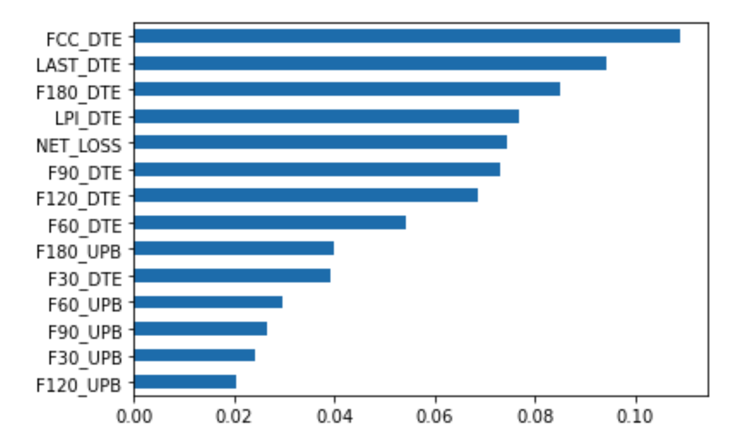
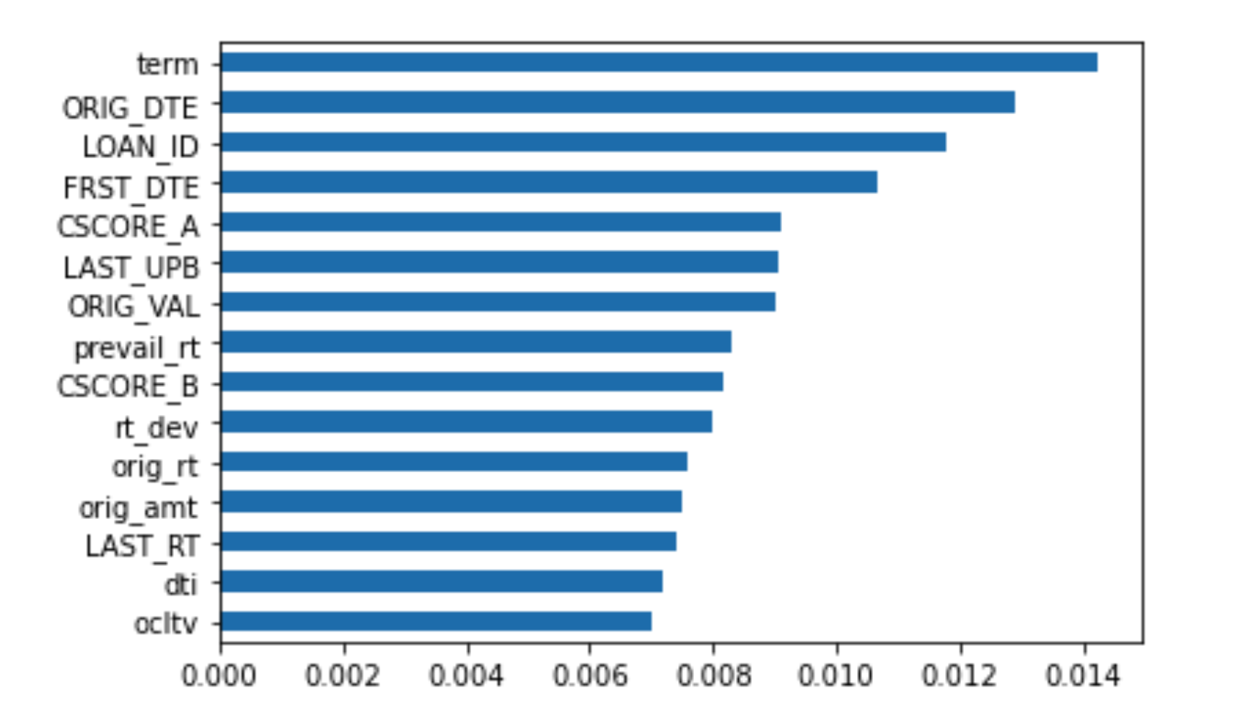
Random Forest Model
Feature importance Score
Random Forest Model Feature Scores
The feature importance score gives us insight into the segments of choosing
Since you cannot segmenting based on “_DTE” and “_UPB”, we main focus on the variables on the figures below.
Note: The first figure has larger importance score than the second figure.

Slide 18

[Random Forest] Model Performance
Confusion Matrix
Prepaid or Matured Delinquent Deed-in-Lieu;
REO Disposition
Prepaid or Matured
Delinquent
Deed-in-Lieu; REO Disposition

Slide 19
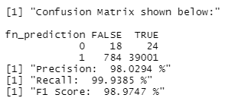
[Linear Regression] Model Performance
Confusion Matrix

Slide 20
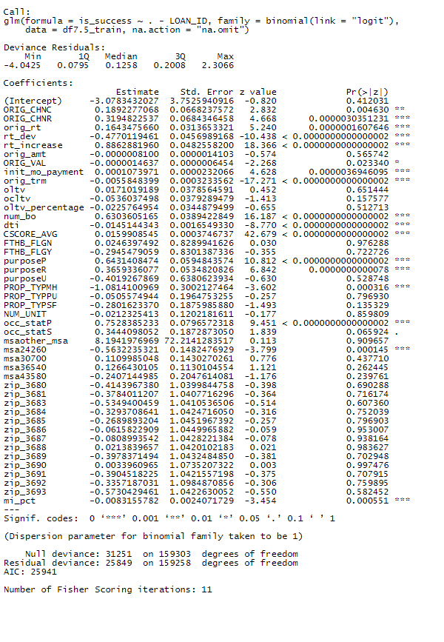
[Linear Regression] Model Performance
Variable Summary

Slide 21
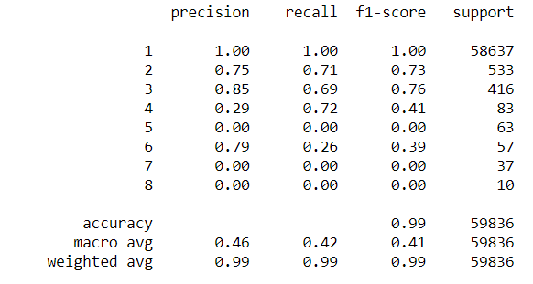
[Stochastic Gradient Descent] Models Performance
Stochastic Gradient Descent
P = Prepaid or Matured
D = Delinquent
F = Deed-in-Lieu; REO Disposition
T = Third Party Sale
R = Repurchased
S = Short Sale
L = Reperforming Loan Sale
N = Notes Sales
P
D
F
T
R
S
L
N

Slide 22
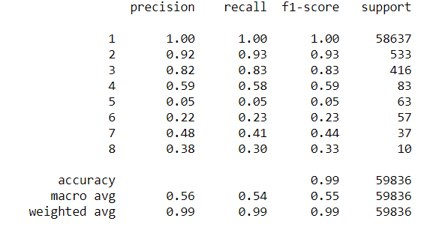
[Decision Tree] Model performance
Decision Trees
P = Prepaid or Matured
D = Delinquent
F = Deed-in-Lieu; REO Disposition
T = Third Party Sale
R = Repurchased
S = Short Sale
L = Reperforming Loan Sale
N = Notes Sales
P
D
F
T
R
S
L
N

Slide 23
Appendix B
Miscellaneous

Slide 24
Confirm Dataset Size & Share
Confirmed that Dataframe represents appx. all NE conforming FRM sold to FNMA
The team wanted to confirm if the dataframe in fact represents the entire Nebraska Conforming FRM that was sold to FNMA.
According to “Mortgage Bankers Association’s Databook of State and National Mortgage Originations 2013” report, page 20 & 24, FNMA purchased between $2 - 2.5 billion in mortgages in 2012 and 2013 each, which is broadly in line with the sum of `orig_amt` from our dataset in 2012 and 2013.
The team therefore confirms that the dataset can be treated as the complete Nebraska Confirming FRM market that’s sold to FNMA, not a percentage of the total.

Slide 25
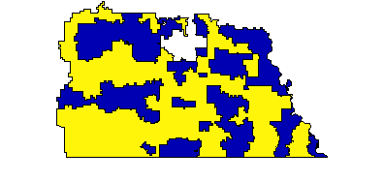
Maybe explain merging zip_3 == 683 & 684?
Because the map of 3-digit ZIP code map of 683 and 684 are random and intertwined, for our purpose they are treated as one.
Throughout the slide, when zip_3 of 683 is invoked, it means the union of 683 and 684.

Slide 26
Thank you
Oct 13th, 2021

